Slide 1
Oga Landlord – Democratizing Property Ownership in Africa
Capstone Project – Product Management By Paulinus Blessing Tagline – “From Tenant to Oga — One Share at a Time”

Slide 2
The Big Idea: Solving the Property Ownership Barrier in Africa
Problem:
Property ownership requires huge upfront capital (millions of naira).
Many fear scams due to lack of transparency in property records.
Renters remain stuck in a cycle with no path to ownership.
Why It Matters:
Housing is both a basic need and a wealth-building tool.
Millions of young Africans (especially 25–40 years old) can’t afford homes.
Real estate contributes to financial stability and generational wealth.
Who Has This Problem?
Middle-income earners, civil servants, entrepreneurs, and young professionals who earn steady income but can’t raise full property payments.

Slide 3
Our Vision & Mission
Mission (Action-driven, measurable): →To connect 5,000 Africans to verified property investments within the first 3 years through secure fractional ownership.
Vision (Future we see): →A future where every African, regardless of income, can confidently own a share of real estate and build generational wealth.
User Promise:
Affordability: Start with as little as ₦50,000.
Transparency: Verified properties with documentation and insurance.
Profitability: Earn rental income while growing your ownership.

Slide 4
MARKET RESEARCH: USER INSIGHTS CUSTOMER SEGMENTATION
Market Research Insights
. Age group 18-34 mostly renters or living with family.
. Top barriers: High cost & Fear of scams.
. 80%+ interested if investment starts small & affordable.
. Trust factors: Verified documents, Government/insurance backing, Transparency.

Slide 5
We conducted a short survey with 28 participants to understand perceptions about property ownership and investment. The results highlight key pain points and desires among our target users:
Figure 1, 2, 3: User research showing distribution of potential customers

Slide 6
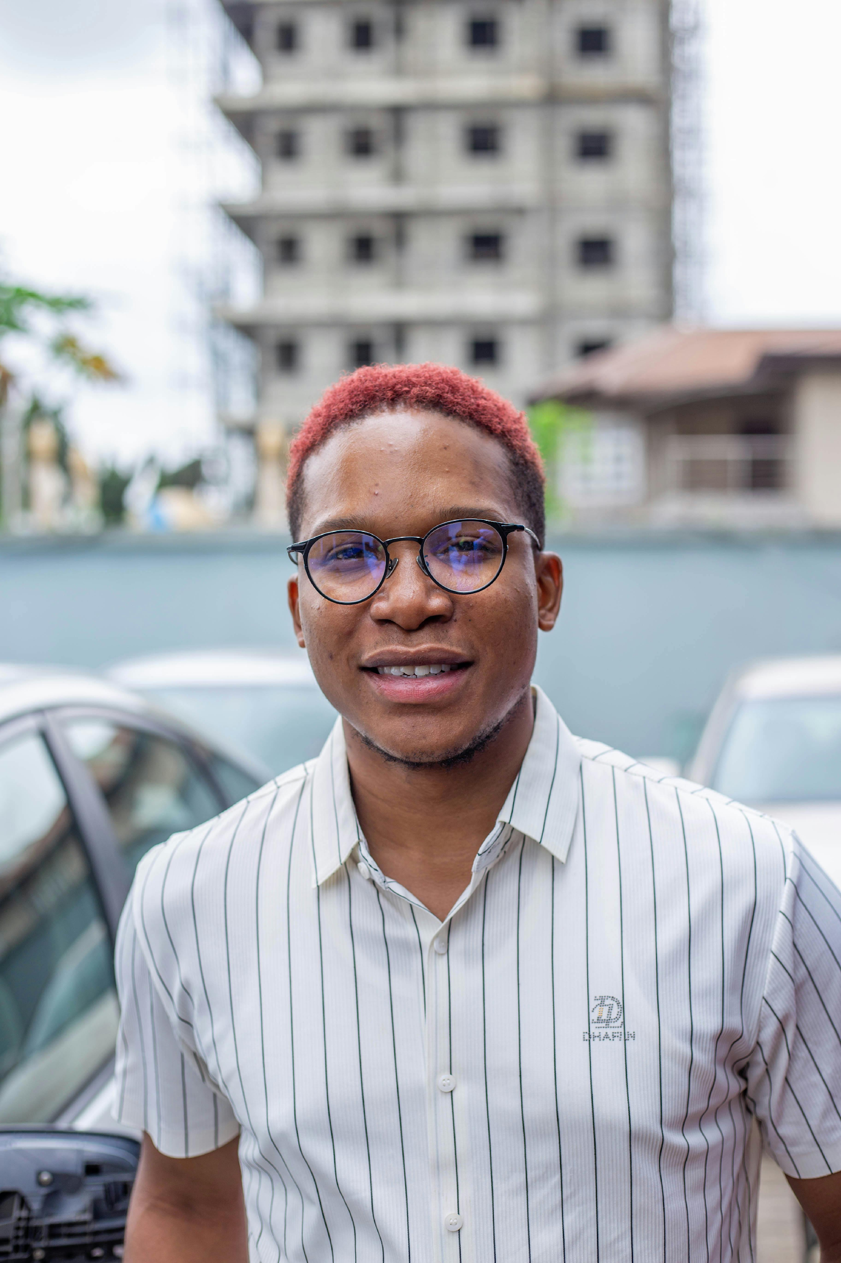
User Persona 1
Psychographics
Pain Points
. Believes in financial independence, values security and long-term planning
. Cannot raise ₦10M+ lump sum; worried about inflation & endless rent payments
Goals
Behaviors
Chinedu, 30, Bank officer
. Want to own a property without taking a massive loan
. Build wealth steadily.
. Saves on apps like PiggyVest & Opay
. Researches property price online
. Follow Finance blogs

Slide 7

User Persona 2
Psychographics
Pain point
. Risk taker but prefers verified investments
. Values digital-first, easy solutions
. Traditional real estate is too rigid, and lacks transparency.
Behaviors
Goals
Mary, 27, Young Professional Investor
. Uses Binance, Bamboo, and investment groups
. Attends financial webinars
. Active on Twitter and Linkedin
. Diversify beyond crypto/stocks into real estate
. Earn passive income early in her career

Slide 8

User Persona 3
Psychographics
Pain Points
. Family-oriented, values trust, transparency, and legacy building
. High risk of fraud when investing from Abroad . No Trusted digital platform for verified property ownership
Goals
Behaviors
Mr. Ade, 42, Diaspora Investor
. Own verified property in Nigeria without the fear of scams
. Create a secure inheritance for children.
. Sends remittance Monthly
. Consults Family before making financial decisions
. Consumes real estate YouTube content

Slide 9
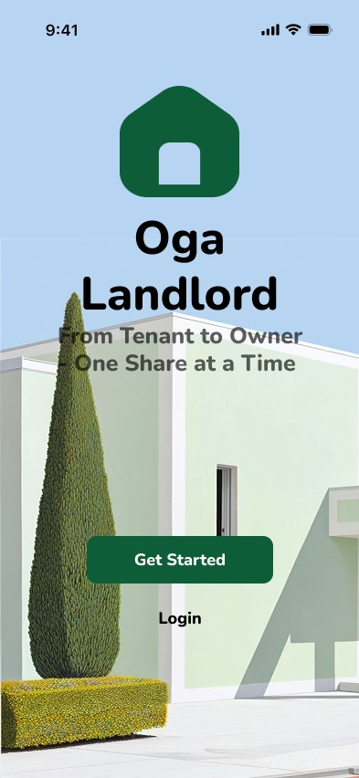
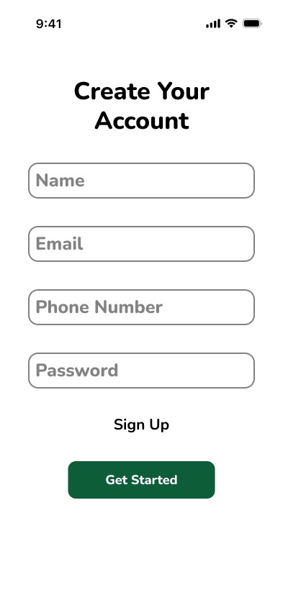
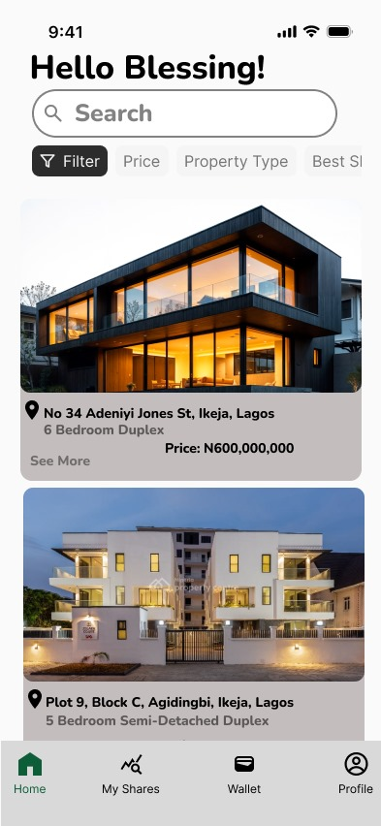
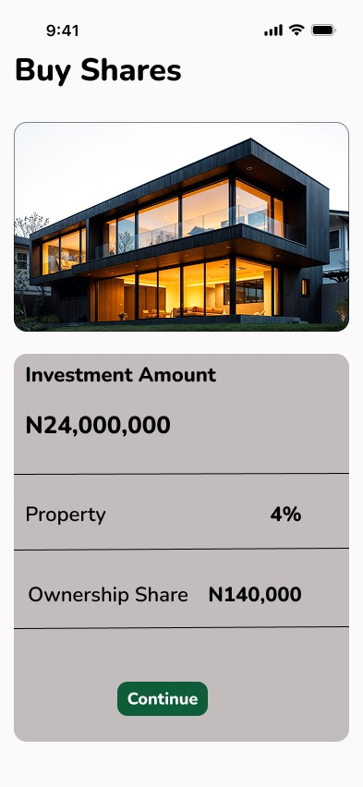
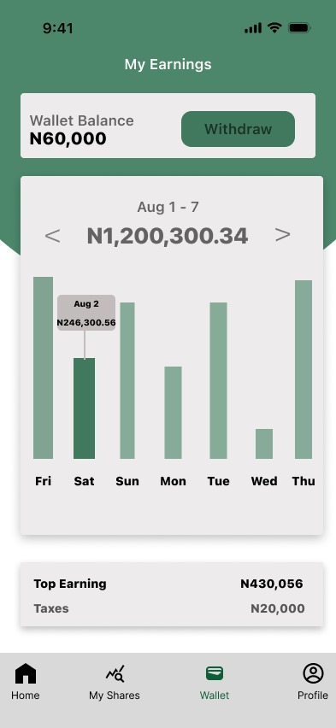
Product Prototype

Slide 10
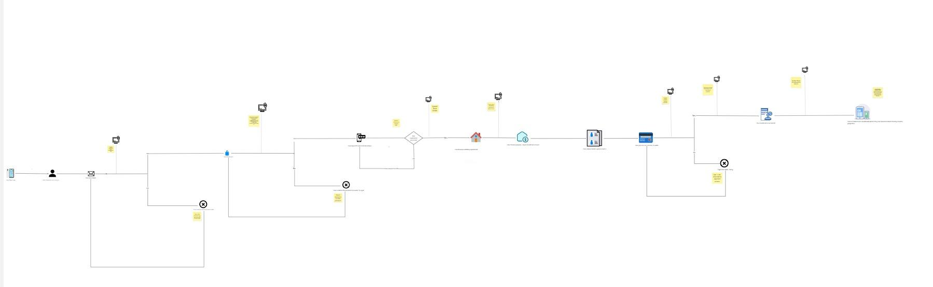
User flow
https://miro.com/app/board/uXjVJeLVtiM=/?share_link_id=898483272801

Slide 11
Product Goals and Metrics
Goal#1
Become the go-to platform for young professionals and middle-income earners looking to invest in fractional real estate.
Time Frame:
Year 1 (Launch – 12 months)
Metric
#5,000 verified users & #500M worth of property shares sold

Slide 12
User Stories
As a user, I want to be able to sign up on the app.
As a user, I want to be able to complete KYC verification so I can be verified before investing.
As a user, I want to be able to login on the app so I can access all features.
As a user, I want to be able to view verified property listings.
As a user, I want to be able to buy fractional property shares.
As a user, I want to be able to see my ownership certificate in-app.
As a user, I want to be able to view my investment dashboard to track my earnings.
As a user, I want to be able to receive monthly payouts into my bank account or wallet.
As a user, I want to be able to update my profile details.
As a user, I want to be able to receive notifications (e.g., payout alerts, new property listings).
As a user, I want to be able to log out of the app.

Slide 13
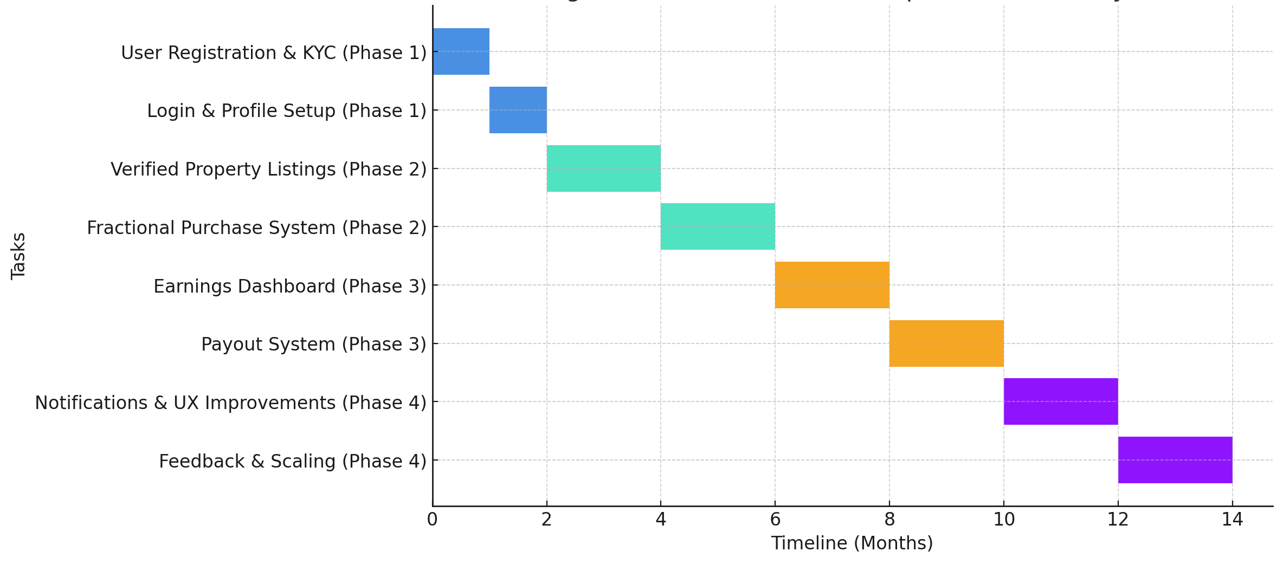
Key Timeline Goals

Slide 14
Go-To-Market-Strategy The target audience is young professionals, students, and first-time investors who want affordable entry into real estate. They can be reached primarily through digital channels and trusted partnerships.
Acquisition Channels:
. Targeted social media ads (Instagram, TikTok, Twitter)
. Influencer marketing with finance coaches & real estate bloggers
. Partnerships with microfinance banks & savings groups
. Educational webinars on “How to Start Investing with ₦50,000”

Slide 15
Metric for Success
User Acquisition Rate – Track how many new users sign up monthly.
Share Purchase Volume – Measure the total amount invested in property shares.
Monthly Active Users (MAU) – Monitor engagement on the platform.
Rental Income Payouts – Value distributed to fractional owners.
Upgrade Rate – Users moving from small shares to larger ownership.

Slide 16



Contact Me
blessingpaulinus291@gmail.com
+234 903 821 3213
linkedin.com/in/blessing-paulinus
🙏 Thank you for your time!

